Slide 1
App UI / UX Images

Slide 2
Select Product
Select Product
Image 1
Name 1
Description 1
Description 1
Image 2
Name 2
Description 2
Description 2
Image 3
Name 3
Description 3
Description 3
Image 4
Name 4
Description 4
Description 4
Image 5
Name 5
Description 5
Description 5
Admin

Slide 3
Select Volume
Select Volume
Image <Selected Product>
Name <Selected Product>
Description <Selected Product>
Description <Selected Product>
500ml
1L
2 L
Rs. xxx
Rs. xxx
Rs. xxx
Please ensure your bottle is big enough to collect the selected quantity

Slide 4
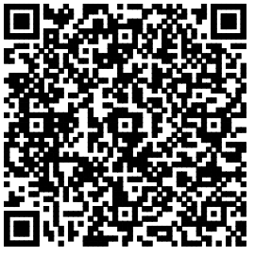
Payment QR Code
Your Selection
Image <Selected Product>
Name <Selected Product>
Description <Selected Product>
Description <Selected Product>
X ml
Rs. xxx
Payment Timeout in <90 second timer> seconds

Slide 5
Confirm Dispensing
Please confirm when you have placed your bottle under the right nozzle
I am Good to Go,
START DISPENSING

Slide 6
Now Dispensing
Video file / GIF
Yay! You are one of us now, saving the planet,
ONE BOTTLE AT A TIME

Slide 7
Transaction Complete Options
Yay! You are one of us now, saving the planet,
ONE BOTTLE AT A TIME
What would you like to do?
REFILL ANOTHER PRODUCT
SHARE FEEDBACK
I AM DONE, THANK YOU!

Slide 8

Share Feedback
We are excited to hear from you
Concept
Ease of Operation
Pricing
What can we do to improve your experience

Slide 9
Selection Timeout
Oops! Your selection timed out, start over again

Slide 10
Payment Timeout
Oops! Your payment timed out, start over again

Slide 11
Out of Stock
It’s not you, It’s Us
Sorry that we are Out of <Selected Product> currently
REFILL ANOTHER PRODUCT
SHARE FEEDBACK
I AM DONE, THANK YOU!

Slide 12
Machine Breakdown
We are very sorry, something seems to be broken and we’ll try and fix it ASAP

Slide 13
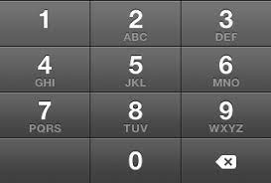
Refill Admin – Pin
Refill Admin
Enter Pin
_ _ _ _ _ _

Slide 14

Refill Admin – Refill Selection
Which Product Containers did you replace today?
Product 1
Product 2
Product 3
Product 4
Product 5
SUBMIT

Slide 15

Refill Admin – Confirm Selection (Checkboxes as per selection on previous screen)
Confirm Input
Product 1
Product 2
Product 3
Product 4
Product 5
CONFIRM
CHANGE

